Slide 1

CSE (H) with specialization in Machine Learning and Artificial Intelligence
Soft Computing
Chapter -2.3
By: Dr. Monika Singh E11032
DISCOVER . LEARN . EMPOWER

Slide 2
Course Objectives
To introduce soft computing concepts and techniques of artificial neural networks, fuzzy sets, fuzzy logic and genetic algorithms
To understand the various techniques from the application point of view.
To analyze various soft computing techniques and decide the technique to be used in a particular problem situation.
To implement soft computing based solutions for real-world problems

Slide 3
Course Outcomes
CO1 | Identify and describe soft computing techniques and their roles in building intelligent. Machines | 1
CO2 | Recognize the feasibility of applying a soft computing methodology for a particular problem. | 2,4
CO3 | Apply fuzzy logic and reasoning to handle uncertainty and solve engineering problems, genetic algorithms to combinatorial optimization problems and neural networks to pattern classification and regression problems. | 3
CO4 | Effectively use modern software tools to solve real problems using a soft computing approach. | 3
CO5 | Evaluate various soft computing approaches for a given problem. | 4

Slide 4
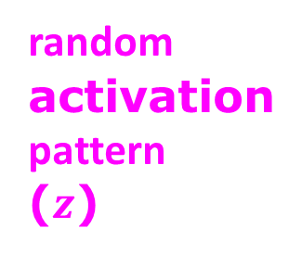
Variational Autoencoders For Pattern Synthesis
Suppose we want to use an autoencoder to generate images.
random
activation
pattern
($z$)
Decoder
Encoder

Slide 5
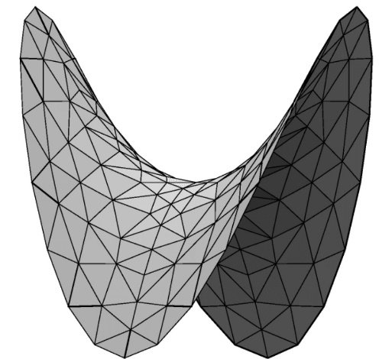
Problem With Using Decoder For Generation
Because we don’t know the distribution of data in the latent space…
No assurance that random activation pattern will produce a sensible output

Slide 6
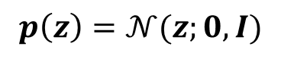
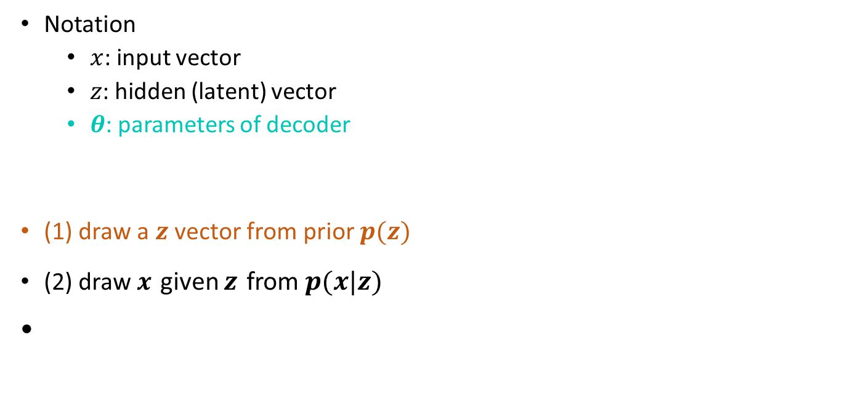
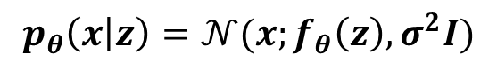
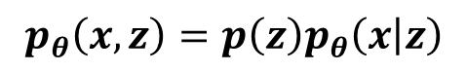

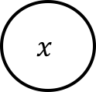

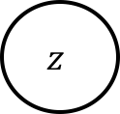

Reinterpreting Decoder As Probabilistic Model
Notation
$x$: input vector
$z$: hidden (latent) vector
$θ$: parameters of decoder
(1) draw a $z$ vector from prior $p(z)$
(2) draw $x$ given $z$ from $p(x|z)$
$$x$$
$$θ$$
$$z$$
$$x$$
$$p_{θ}\left(x,z\right)=p\left(z\right)p_{θ}\left(x | z\right)$$
$$p_{θ}\left(x | z\right)=𝒩(x;f_{θ}\left(z\right),σ^{2}I)$$
$$z$$
$$p\left(z\right)=𝒩(z;0,I)$$
Notes:
probabilistic perspective: x and z are random vectors, and the probabilistic model is specified by the joint distribution over the variables

Slide 7
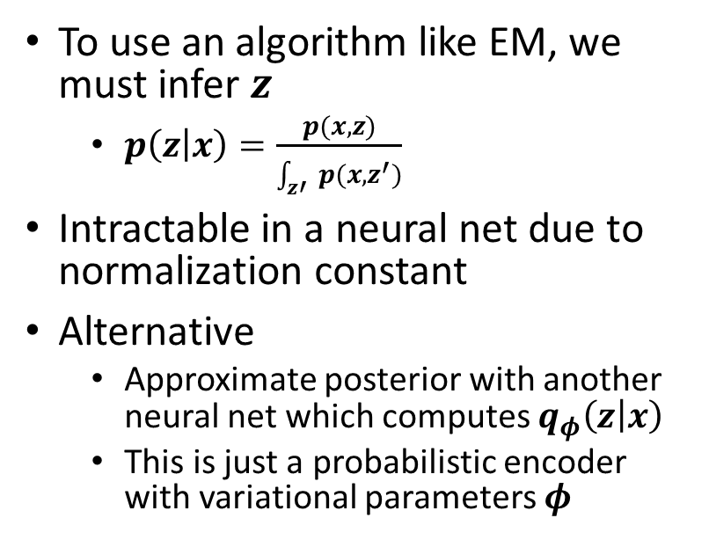
How Do We Train Decoder?
To use an algorithm like EM, we must infer $z$
$p\left(z | x\right)=\frac{p(x,z)}{\int_{z′}{p(x,z^{′})}}$
Intractable in a neural net due to normalization constant
Alternative
Approximate posterior with another neural net which computes $q_{φ}\left(z | x\right)$
This is just a probabilistic encoder with variational parameters $φ$
$$x$$
$$θ$$
$$z$$

Slide 8




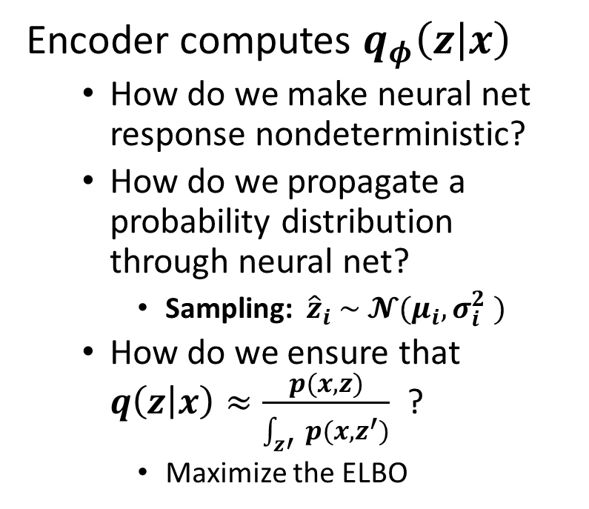





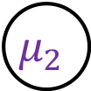

Adding the Encoder
$$x$$
Encoder computes $q_{φ}\left(z | x\right)$
How do we make neural net response nondeterministic?
How do we propagate a probability distribution through neural net?
Sampling: ${\hat{z}}_{i} \sim 𝓝(μ_{i},σ_{i}^{2} )$
How do we ensure that $q\left(z | x\right)≈\frac{p(x,z)}{\int_{z′}{p(x,z^{′})}}$ ?
Maximize the ELBO
$$θ$$
$$x$$
$$\hat{z}$$
$$θ$$
$$z$$
$$μ_{1}$$
$$μ_{2}$$
$$μ_{3}$$
$$σ_{1}^{2}$$
$$σ_{2}^{2}$$
$$σ_{3}^{2}$$
$$φ$$
$$x$$

Slide 9
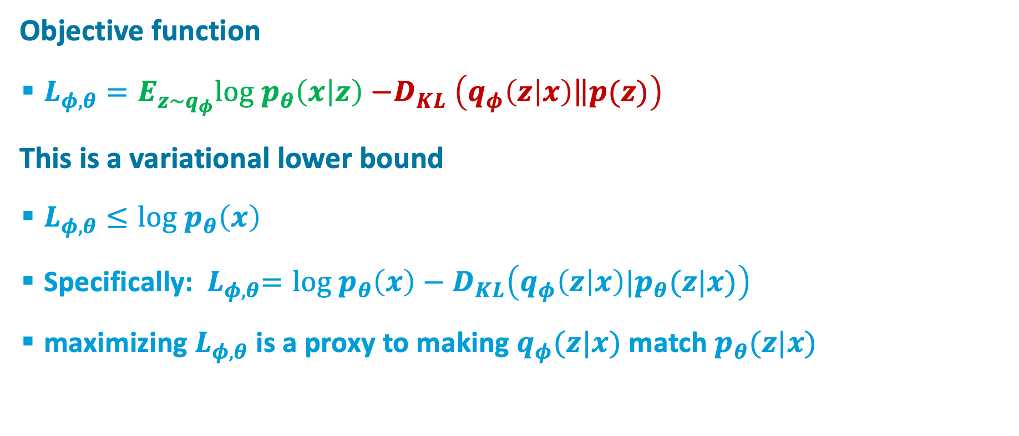
Optimization problem
Objective function
$L_{φ,θ}=E_{z\sim q_{φ}}{log p}_{θ}\left(x | z\right){−D}_{KL}\left(q_{φ}\left(z | x\right)\left\|p(z)\right.\right)$
This is a variational lower bound
$L_{φ,θ}≤{log p}_{θ}\left(x\right)$
Specifically:${ L}_{φ,θ}=log p_{θ}\left(x\right)−D_{KL}\left(q_{φ}\left(z | x\right)|p_{θ}(z|x)\right)$
maximizing $L_{φ,θ}$ is a proxy to making $q_{φ}(z|x)$ match $p_{θ}(z|x)$

Slide 10
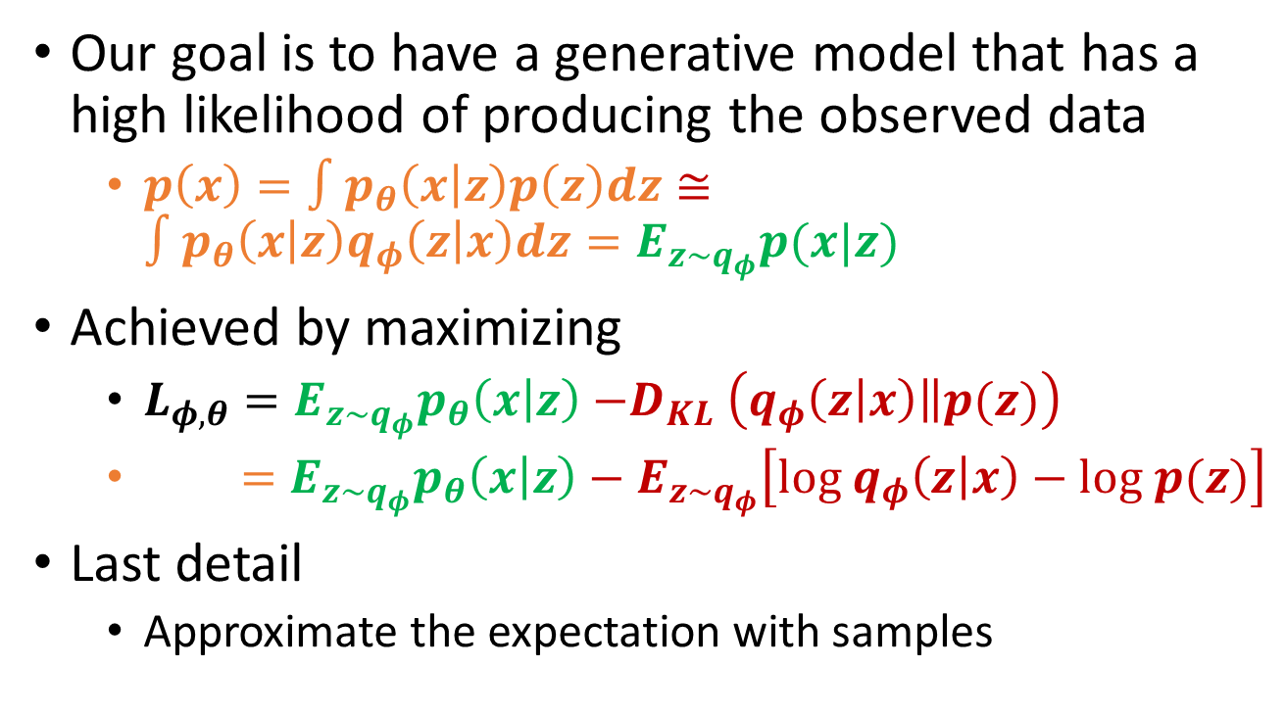
Intuition
Our goal is to have a generative model that has a high likelihood of producing the observed data
$p\left(x\right)=∫p_{θ}\left(x | z\right)p\left(z\right)dz≅{∫p_{θ}\left(x | z\right)q_{φ}\left(z | x\right)dz=E}_{z\sim q_{φ}}p(x|z)$
Achieved by maximizing
$L_{φ,θ}=E_{z\sim q_{φ}}p_{θ}\left(x | z\right){−D}_{KL}\left(q_{φ}\left(z | x\right)\left\|p(z)\right.\right)$
$=E_{z\sim q_{φ}}p_{θ}\left(x | z\right)−E_{z\sim q_{φ}}\left[log{ q}_{φ}\left(z | x\right)−log p(z)\right]$
Last detail
Approximate the expectation with samples

Slide 11
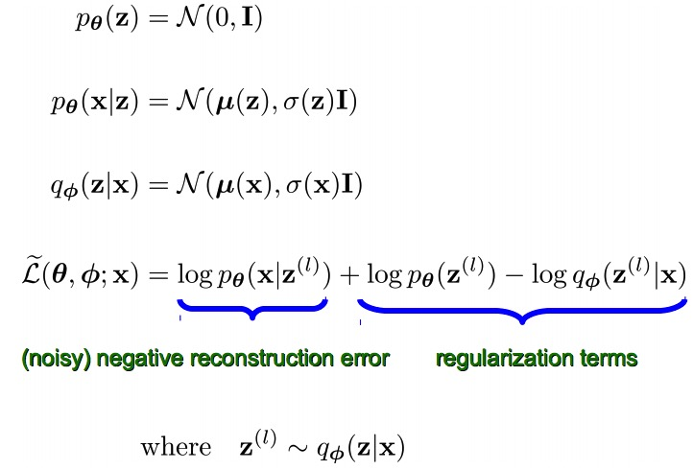
Complete Model
From Kingma ICLR 2014 Slides

Slide 12
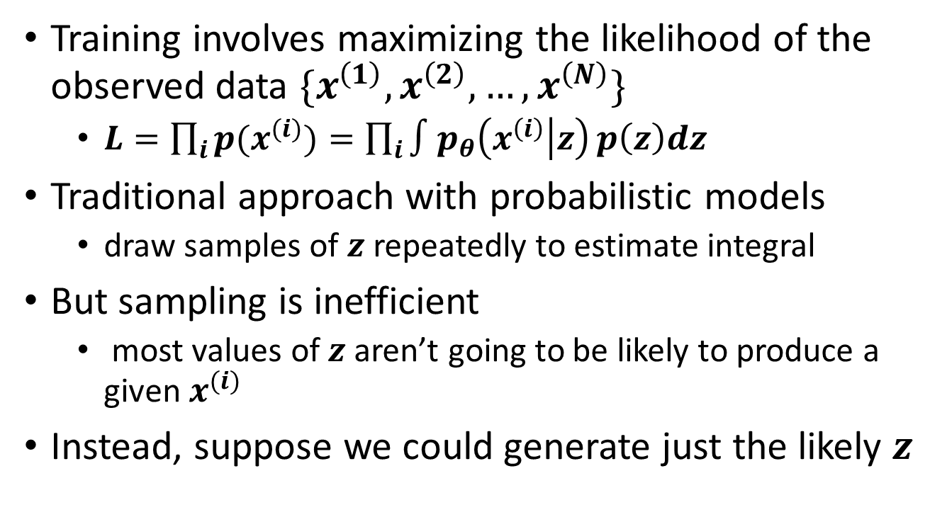
Training the Variational Autoencoder (VAE)
Training involves maximizing the likelihood of the observed data $\{x^{\left(1\right)},x^{\left(2\right)},…,x^{\left(N\right)}\}$
$L=\prod_{i}{{p(x}^{(i)})=\prod_{i}{∫p_{θ}\left(x^{\left(i\right)} | z\right)}p\left(z\right)dz}$
Traditional approach with probabilistic models
draw samples of $z$repeatedly to estimate integral
But sampling is inefficient
most values of $z$aren’t going to be likely to produce a given $x^{(i)}$
Instead, suppose we could generate just the likely $z$

Slide 13
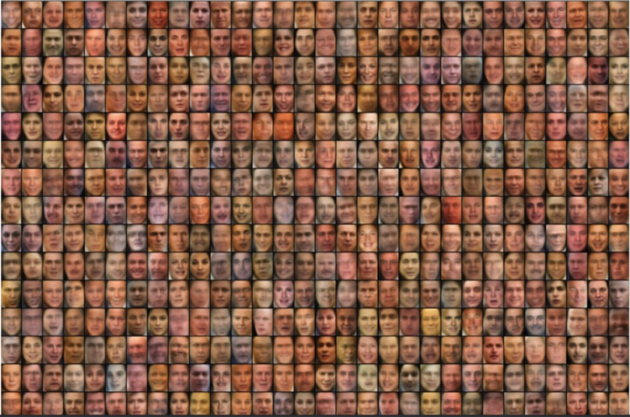
Random Samples From Generative Model Trained on Faces in the Wild
From Kingma ICLR 2014 slides

Slide 14
Examples
VAE faces
VAE faces demo
VAE MNIST
VAE street addresses

Slide 15
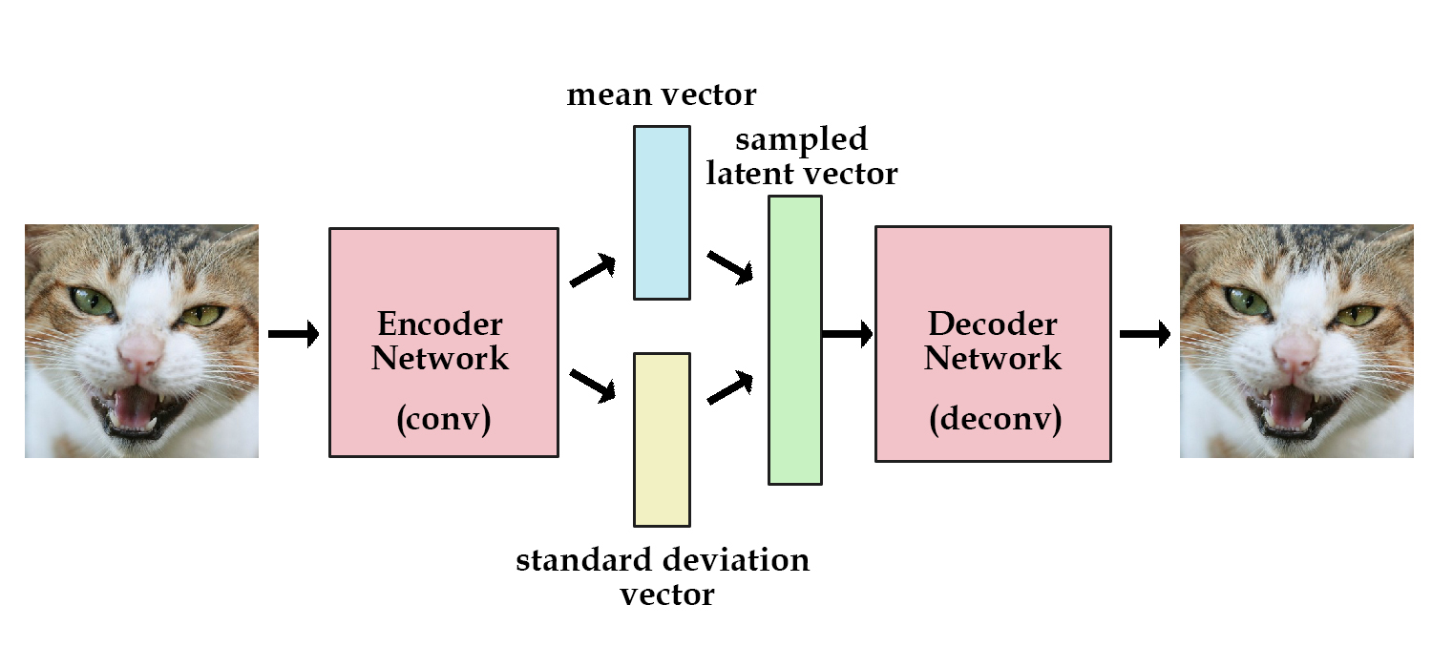
sdfdfd
Image credit: kvfrans.com

Slide 16
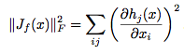
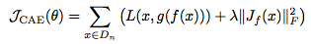
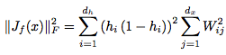
Contractive Autoencoders
A good hidden representation will be insensitive to most small changes in the input (while still preserving information to reconstruct the input)
Objective function
Frobenius norm of the Jacobian
For logistic hidden:
Tries to make the hidden units saturate,
especially where input-to-hidden weights
are large

Slide 17
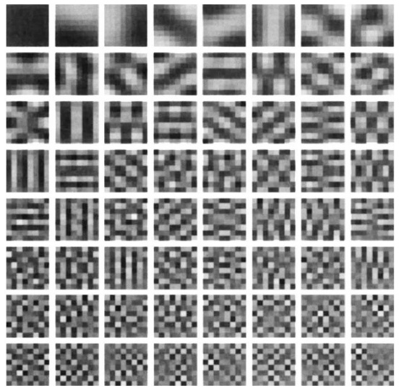
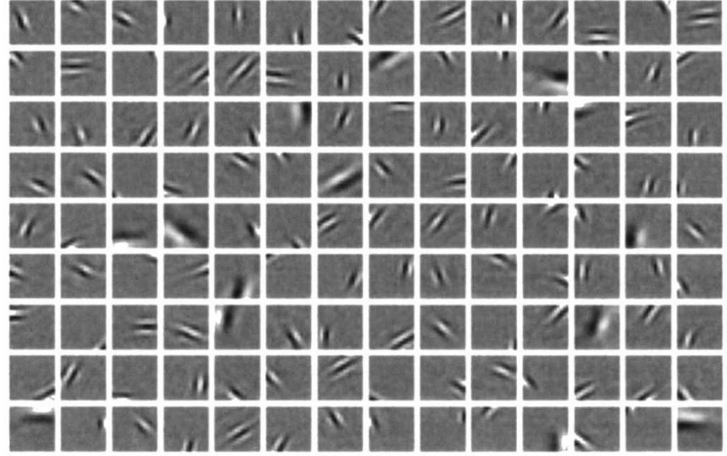
Sparse Encodings
We may wish to have few units in the hidden bottleneck representation for any input
Biological motivation
E.g., unsupervised training on natural image patches
Olshausen
& Field
(1996)
PCA
Notes:
Bruno A Olshausen and David J Field. Emergence of simple-cell receptive field properties by learning a sparse code for natural images. Nature, 381(6583):607–609, 1996. 11.
Honglak Lee, Alexis Battle, Rajat Raina, and Andrew Y Ng. Efficient sparse coding algorithms. In NIPS, 2006.

Slide 18
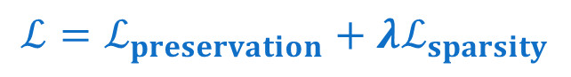
Sparse Encoding
Loss function has two components
information preservation
input reconstruction in autoencoder
mutual information in simple encoder
sparsity constraint
$$ℒ=ℒ_{preservation}+λℒ_{sparsity}$$

Slide 19
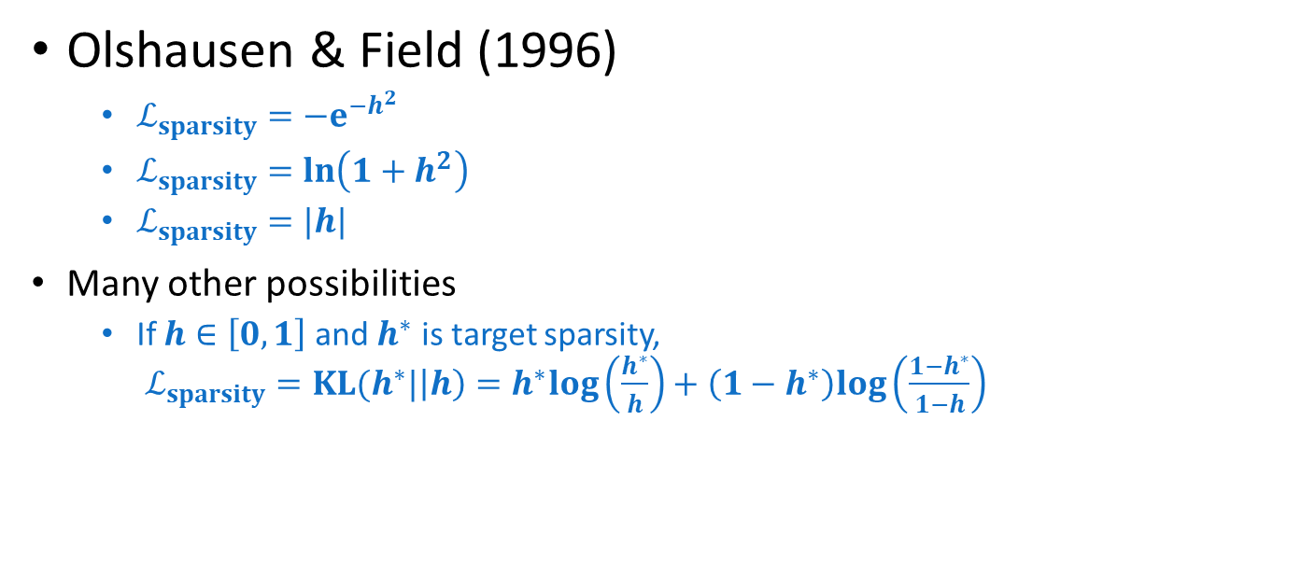
Examples of Sparsity Constraints
Olshausen & Field (1996)
$ℒ_{sparsity}=−e^{−h^{2}}$
$ℒ_{sparsity}=ln\left(1+h^{2}\right)$
$ℒ_{sparsity}=|h|$
Many other possibilities
If $h∈\left[0,1\right]$ and $h^{∗}$ is target sparsity, $ℒ_{sparsity}=KL(h^{∗}|\left|h\right)=h^{∗}log\left(\frac{h^{∗}}{h}\right)+\left(1−h^{∗}\right)log\left(\frac{1−h^{∗}}{1−h}\right)$

Slide 20
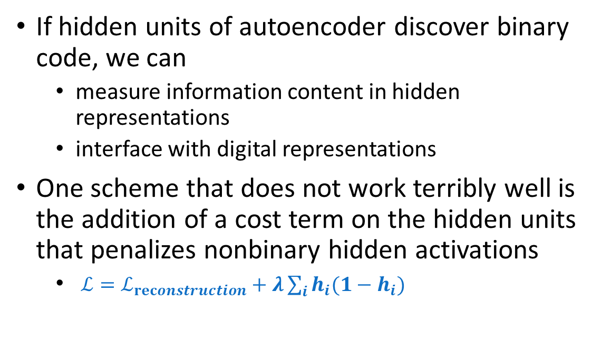
Discovering Binary Codes
If hidden units of autoencoder discover binary code, we can
measure information content in hidden representations
interface with digital representations
One scheme that does not work terribly well is the addition of a cost term on the hidden units that penalizes nonbinary hidden activations
$ℒ=ℒ_{reconstruction}+λ\sum_{i}{h_{i}(1−h_{i})}$
Y
A’
B’
C
B
A
X

Slide 21
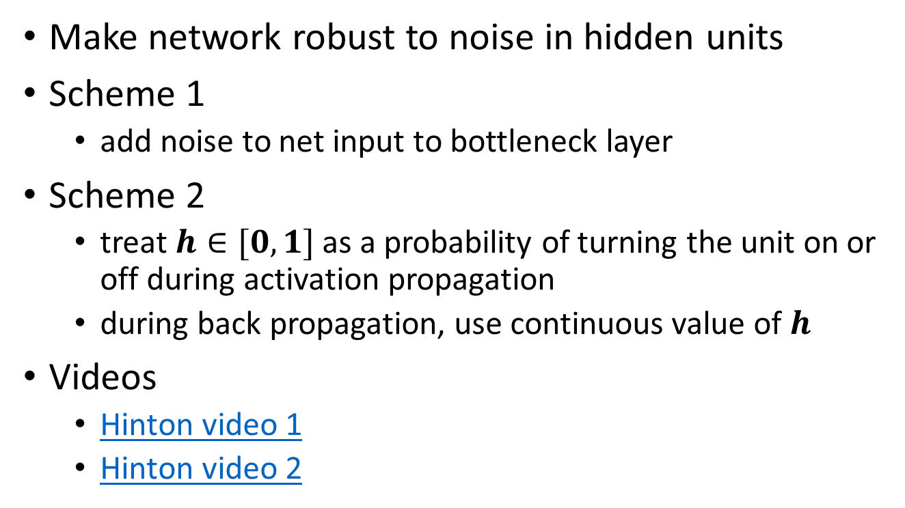
Discovering Binary Codes
Make network robust to noise in hidden units
Scheme 1
add noise to net input to bottleneck layer
Scheme 2
treat $h∈[0,1]$ as a probability of turning the unit on or off during activation propagation
during back propagation, use continuous value of $h$
Videos
Hinton video 1
Hinton video 2

Slide 22
References
“Principles of Soft Computing, 2nd Edition” by S.N. Sivanandam & SN Deepa, Wiley India Pvt. Ltd.
Link :
https://analyticsindiamag.com/6-types-of-artificial-neural-networks-currently-being-used-in-todays-technology/

Slide 23
THANK YOU
For queries
Email: monika.e11032@cumail.in

